Slide 1

About the Author

Slide 2
Agenda
Who am I
Contact info

Slide 3
Who AM I

Slide 4
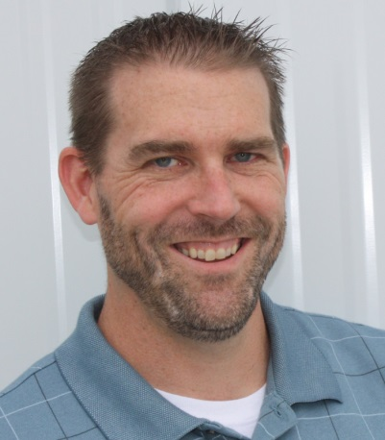
Brian Gorman
12 years programming experience
B.S. Computer Science
M.S. Computer Information Systems
5 years of online computer science instruction
MCSD Certified C#.Net

Slide 5
Have instructed courses or built training modules in:
Java Programming
Algorithms and Design Patterns
JSP/Servlets
C#.Net/VB.Net
SQL Server
Microsoft Office

Slide 6
Contact info

Slide 7
Linked In: [please mention Infinite Skills, J2EE JSP/Servlets, or something similar in the notification if you would like to connect with me: http://www.linkedin.com/in/brianlgorman
My Website: http://www.majorguidance.com/

Slide 8
Wrap Up
I hope you learn a lot from the course
Connect with me on LinkedIn
All feedback welcome and appreciated!

